Slide 1

Acoustic Metamaterials Research Review
Ryan Hill
Matias Mendieta
Patrick Bruce
Ed Stokes
Contact: Ed Stokes
ebstokes@uncc.edu
704-687-8425

Slide 2
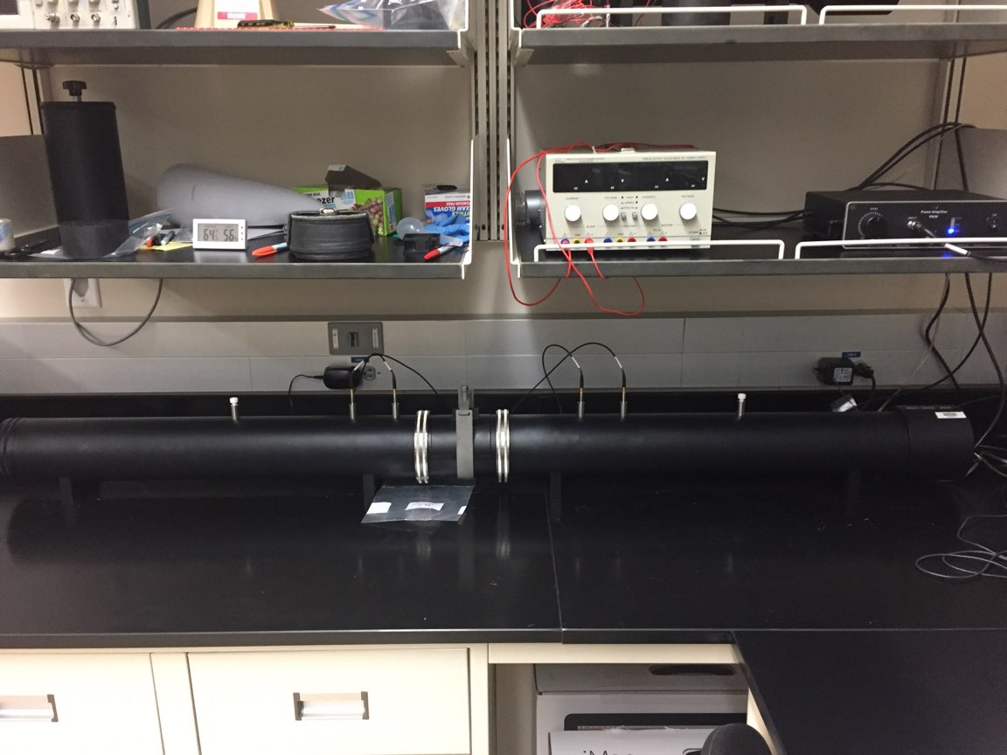
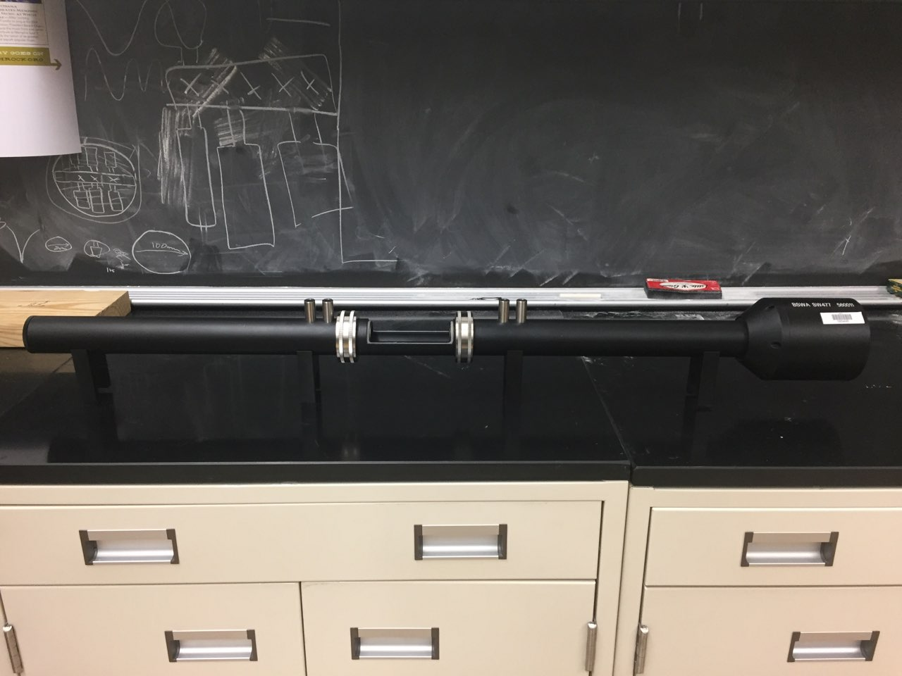
Impedance Tube
 | 100 [mm] | 30 [mm]
Part Number | SW422 | SW477
Operating Frequency | 63[hz] – 1600 [hz] | 1000 [hz] – 6100 [hz]
BSWA SW422 Impedance Tube
Microphones
Speaker
Sample
Holder
BSWA SW477 Impedance Tube
From BSWA Impedance Tubes product literature, version 201008

Slide 3
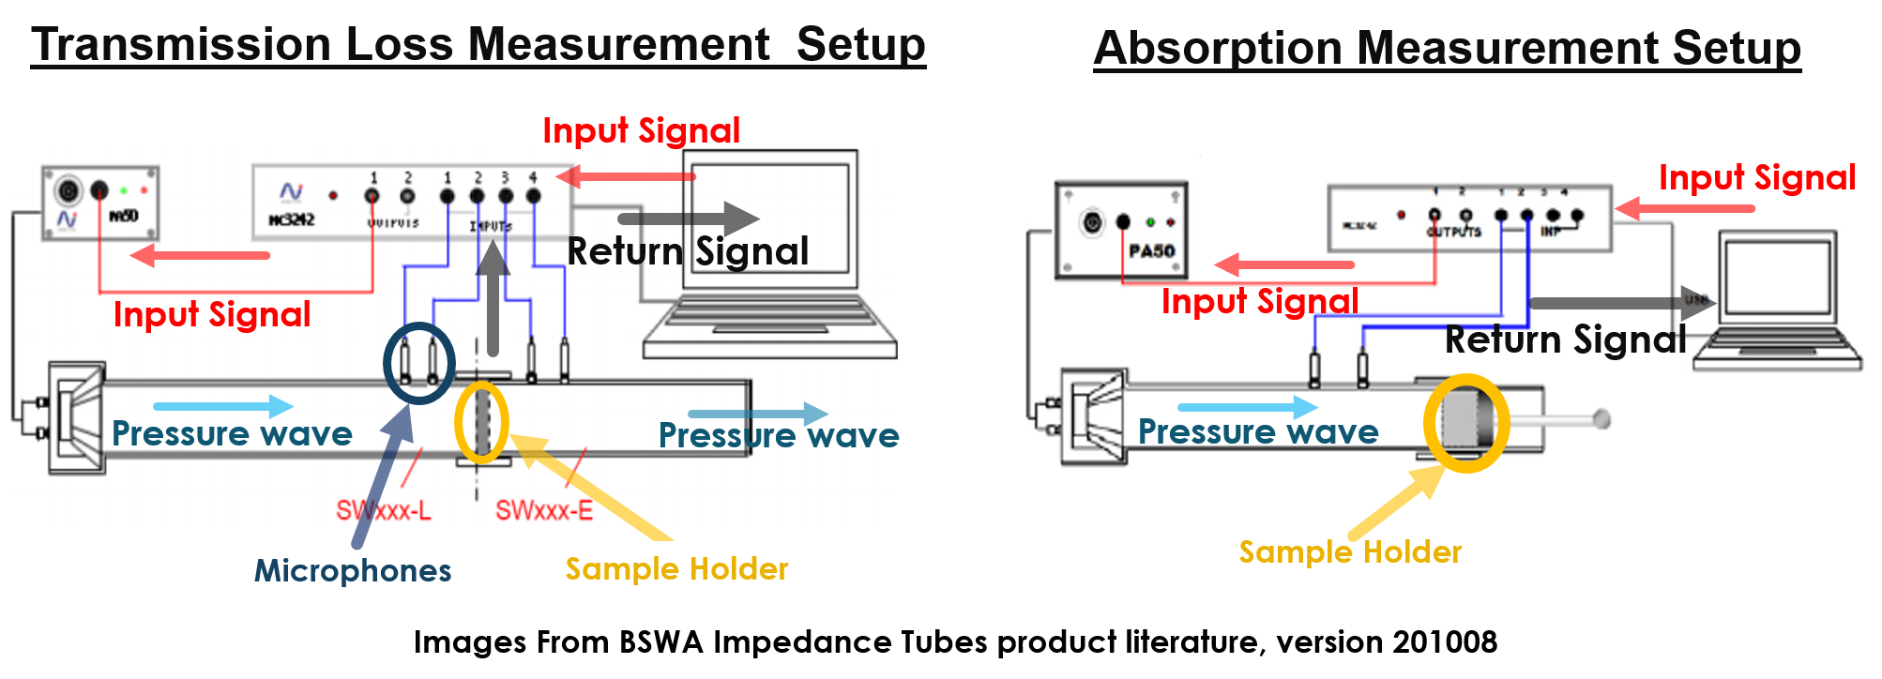
Impedance Tube Measurement Setup
Note: End of tube can be terminated with hard, soft, anechoic, or no boundary, depending on the type of measurement, and following e.g. ASTM procedures.

Slide 4
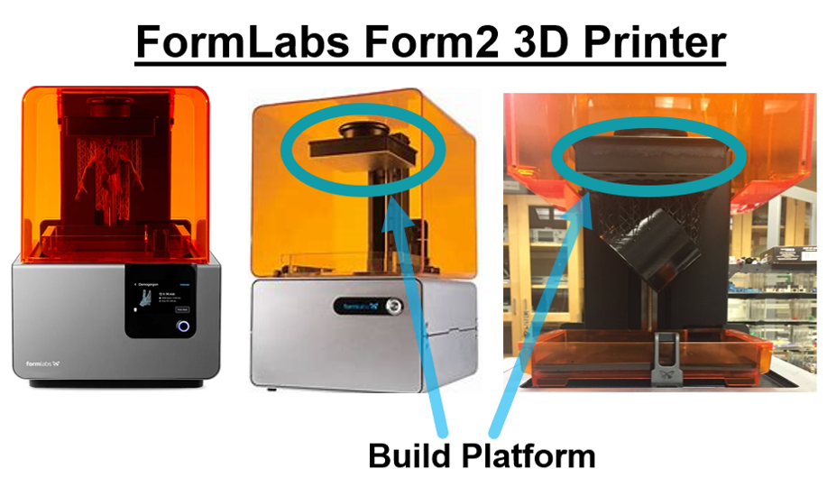
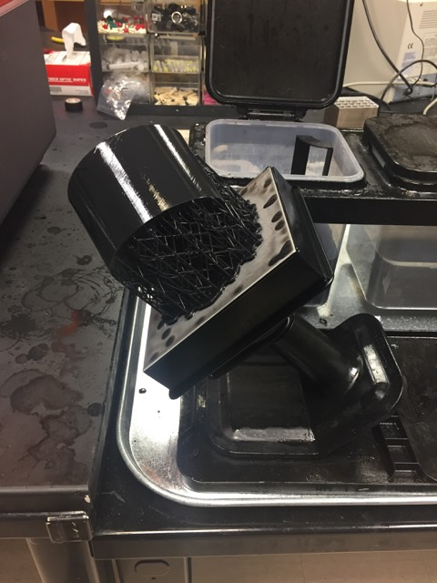
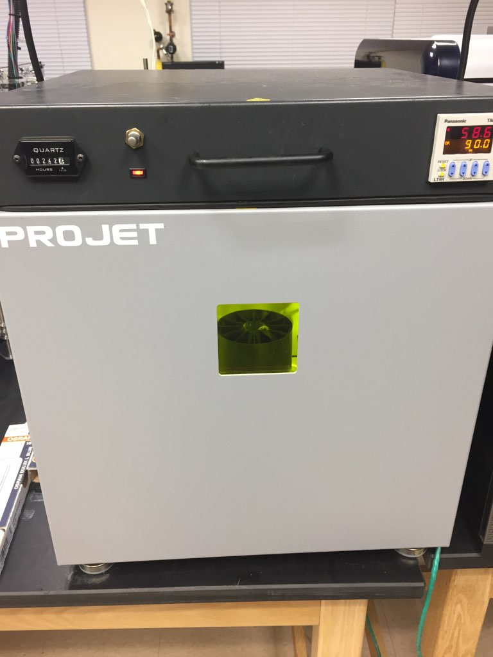
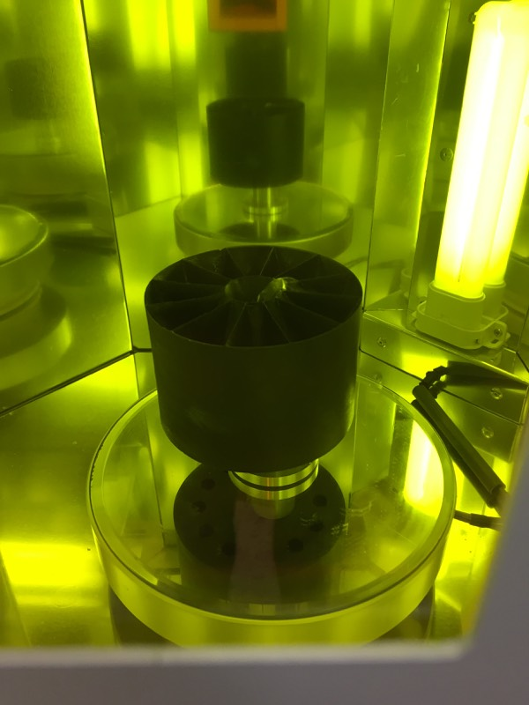
3D printing capabilities in UNC Charlotte Optics Center
After Print Processing of 3D Model
Remove the supports and base. Use Isopropyl Alcohol to rinse the resin off the model
Use Ultraviolet Oven to Cure the Model
Prints the 3D Model upside down, on the build platform
FormLabs Form2 3D Printer Specs.
Max. Build Volume: 145 × 145 × 175 [mm]
Layer Thickness: 0.025 [mm]
Laser Spot Size: 0.14 [mm]
Form2 Black Printer Resin
Methacrylate Photopolymer Resin
Mixture of methacrylic acid esters, photoinitiators, proprietary pigment and additive package

Slide 5
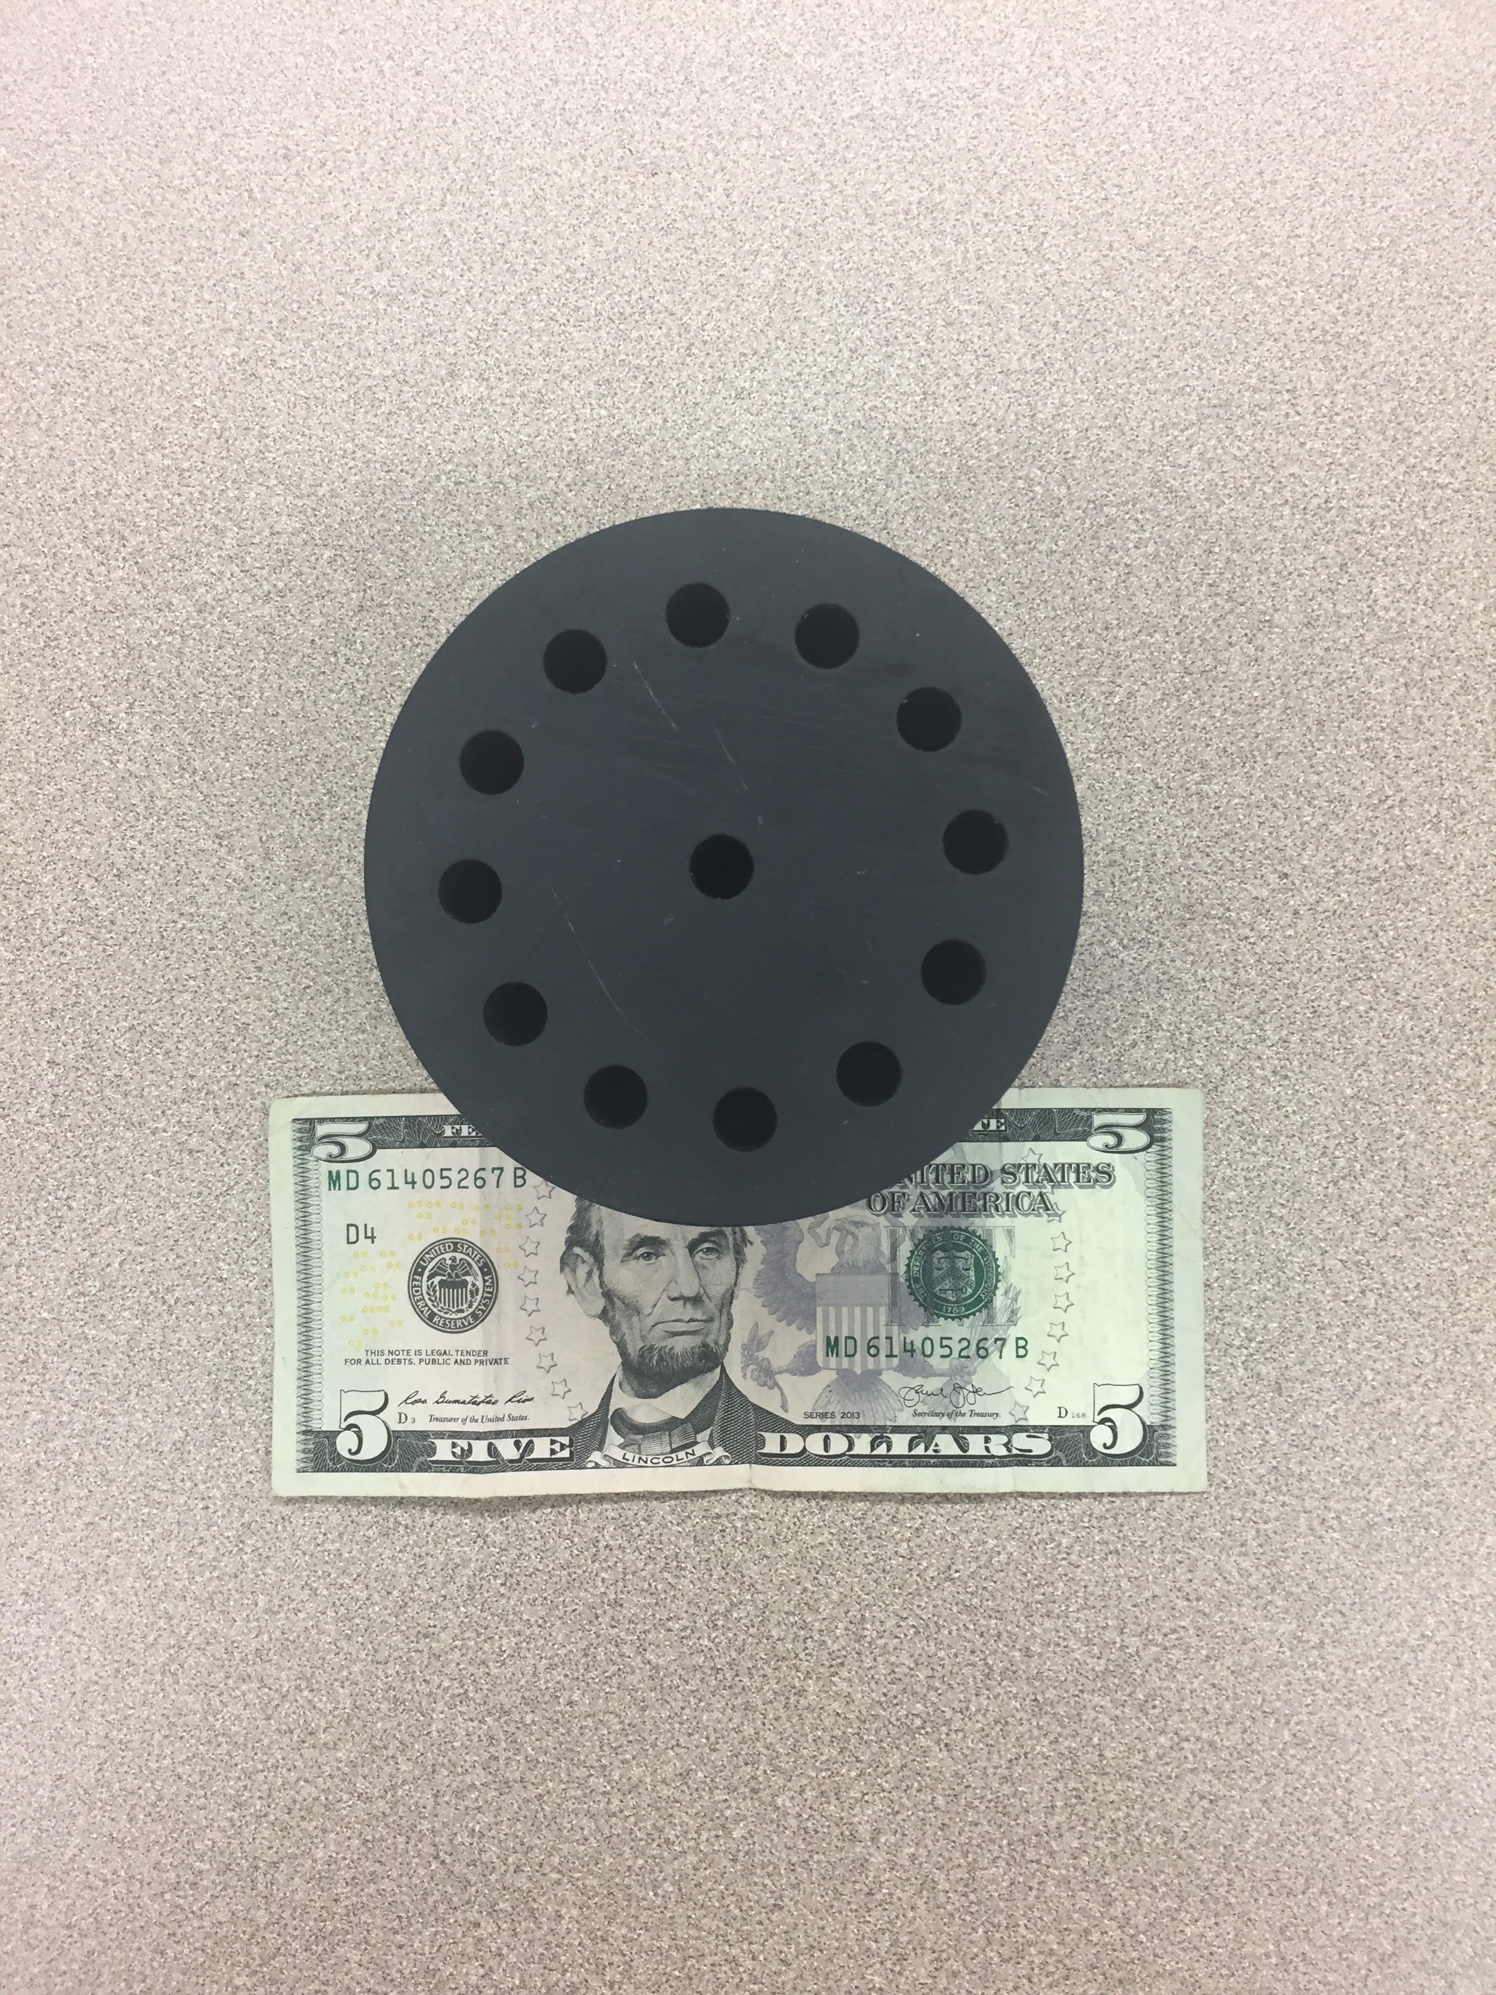
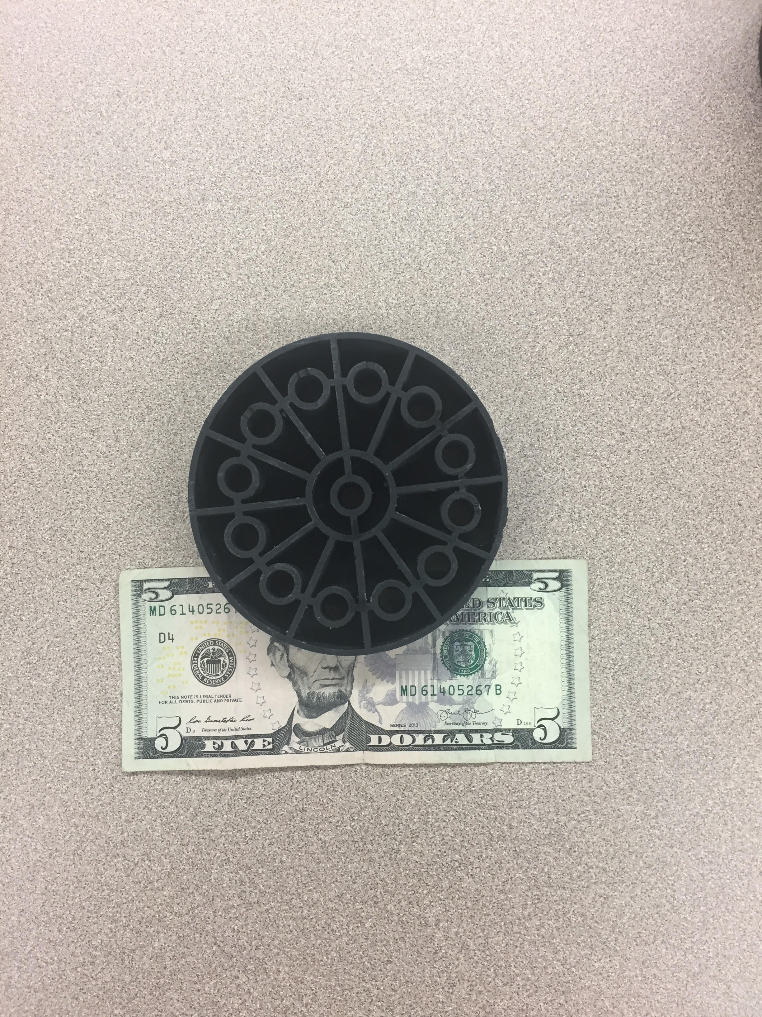
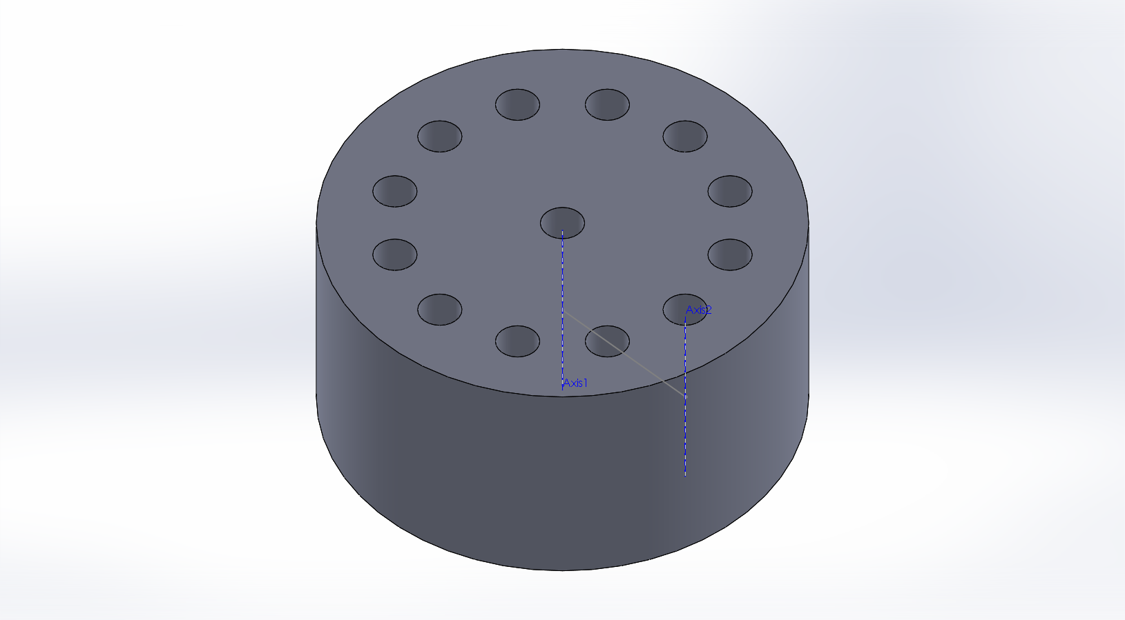
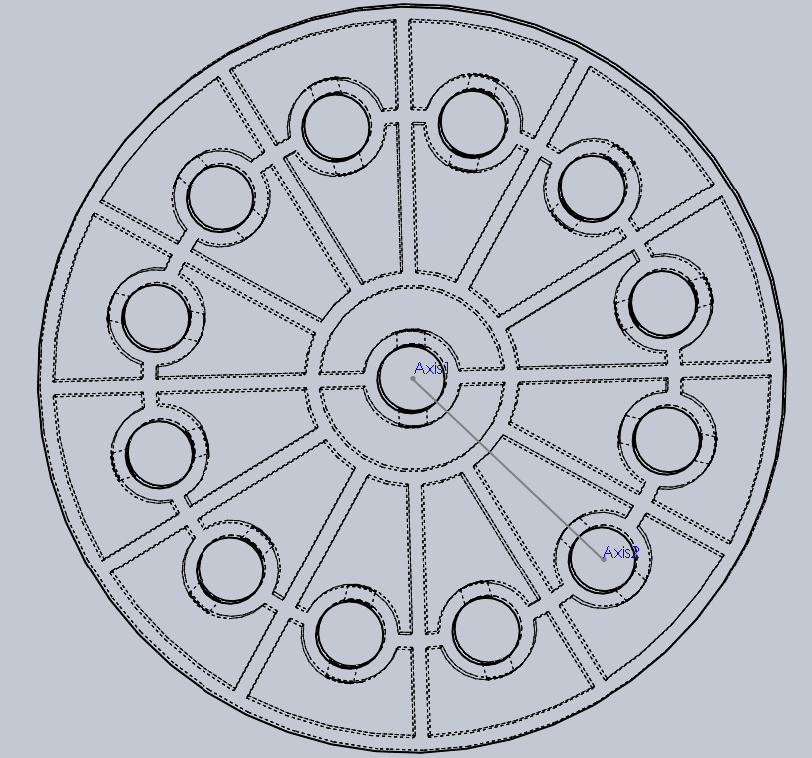
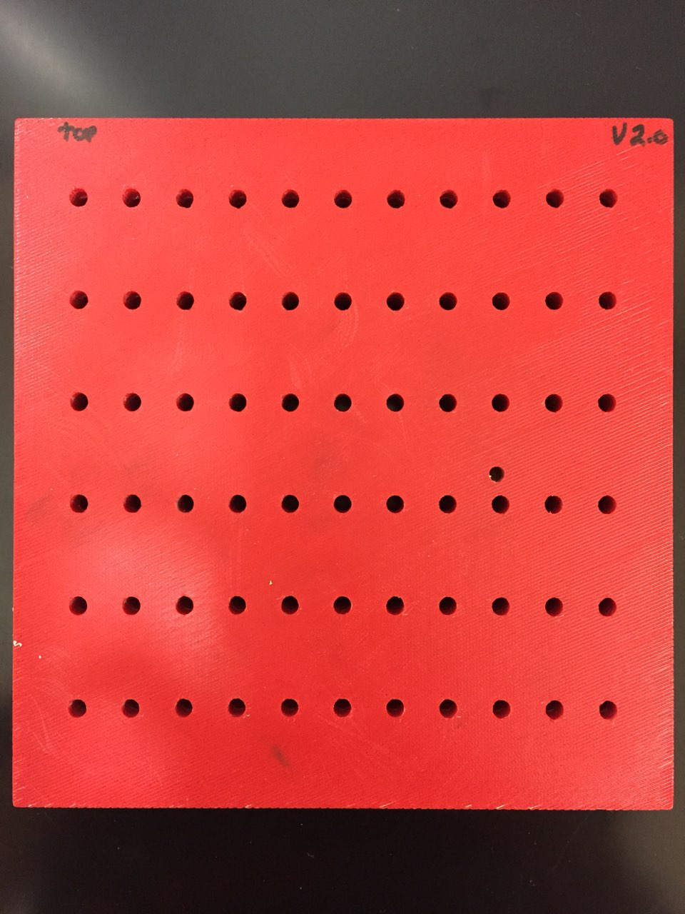
Current sample: optimized number of resonators per unit volume
Shape of resonators tailored to fill available volume.
New sample & cross section
SolidWorks® Design
Outer Resonator
100 mm
Inner Resonator
Waveguide
Current sample specifications
Face Diameter: 100 [mm]
13 waveguides with 9[mm] openings
Waveguide openings are 13*9²/100² or 11% of face area
Depth: 50 [mm]
Volume per Resonator: 7176 [mm³]
Resonance Frequency: ~983 [Hz]
Original Sample (2017):
Large “dead volume”; lower number of resonators per unit volume

Slide 6
Current Sample Transmission Loss Without Flow (no Fan)
Transmission Loss of New Sample
Transmission Loss of Blank Sample
Impedance tube transmission loss measurement
Current sample shows TL of 44 dB at ~1006 Hz, with a satellite peak of 33 dB at ~976 Hz.
Blank sample (waveguides w/no resonators) shows no structured TL

Slide 7
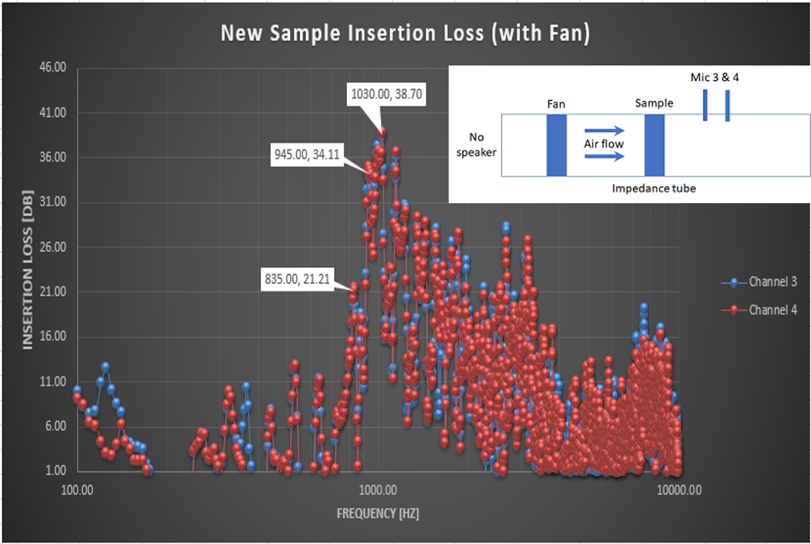
Current Sample Insertion Loss Without Flow (Fan)
Experimental Setup
Used the 100 [mm] impedance tube and the channel 3 & 4 microphones.
No speaker was used; the fan is the only source of sound.
Fan holder was placed into the impedance tube on the source-side of the sample.
Results of New Sample
The Insertion Loss has a bandwidth of ~125 [Hz] and has a range from 925 [Hz] to 1050 [Hz].
Note:
Insertion Loss (this experiment) is the reciprocal ratio of the signal power delivered to a point due through an acoustical device to that of the signal power delivered to the same point before the acoustical device was inserted
Transmission Loss (previous pages) is the difference between the “incident power on an acoustic device and that transmitted downstream into an anechoic termination” [1]. (“The decrease in power that occurs during transmission from one point to another”[2])
[1] https://en.wikipedia.org/wiki/Transmission_loss_(duct_acoustics)
[2] https://www.owenduffy.net/transmissionline/concept/iltl.htm

Slide 8
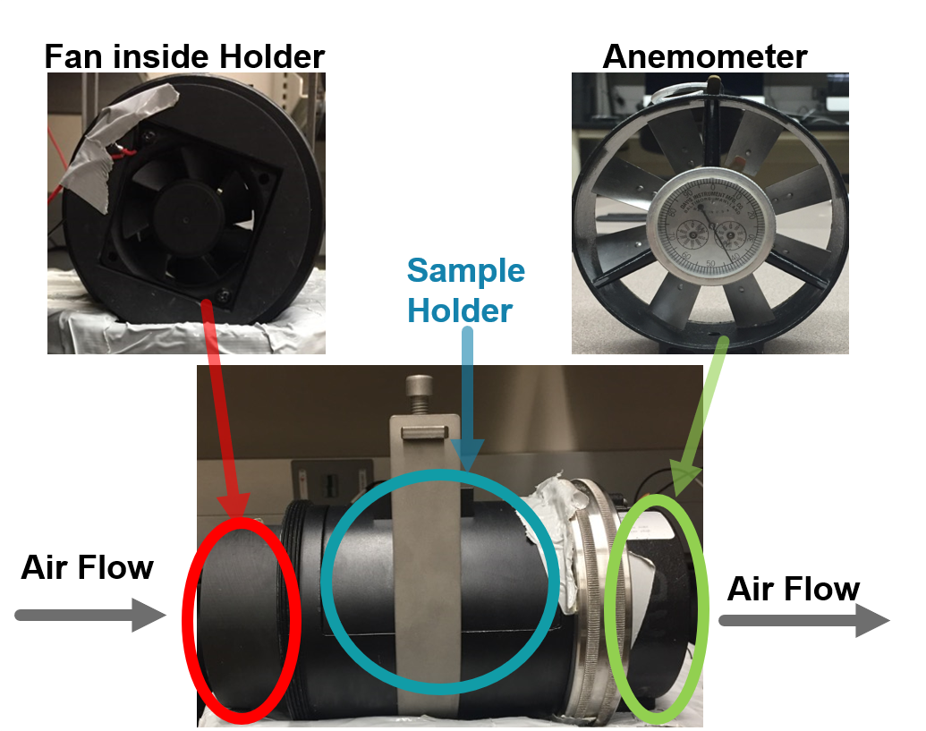
Anemometer Flow Measurements
 | 12 V (Fan Operating Voltage)
Without Sample | 1247 [Ft/min]
With Sample | 301 [Ft/min]
Assuming uniform flow (maybe not a good assumption), only ~24% of the air flow from the fan gets through the sample.
However, the area of the waveguide openings in only 11% of the face of the sample, so 24% is pretty good by comparison.
The new sample design attempts to improve the flow by providing tapered flow channels covering the entire face of the sample.

Slide 9
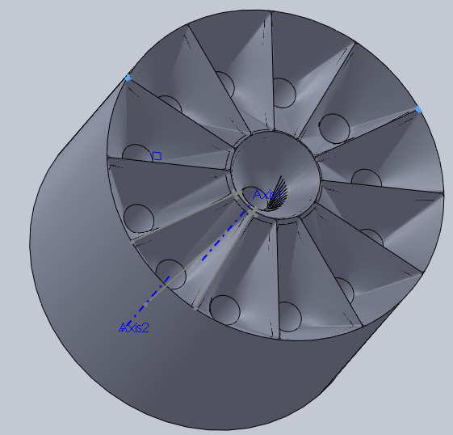
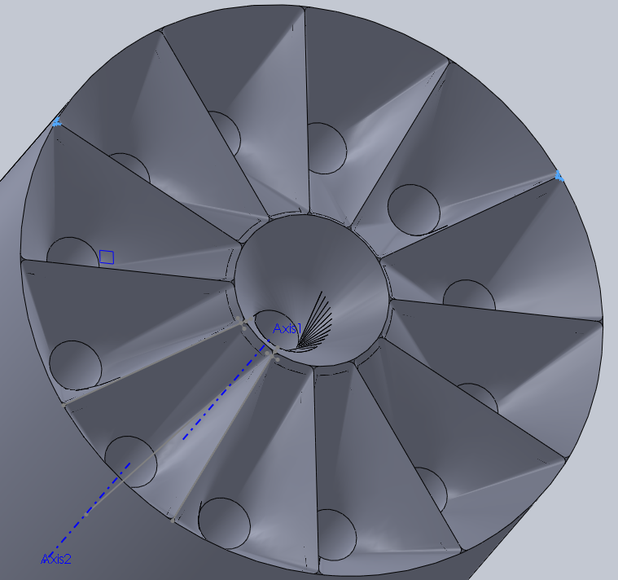
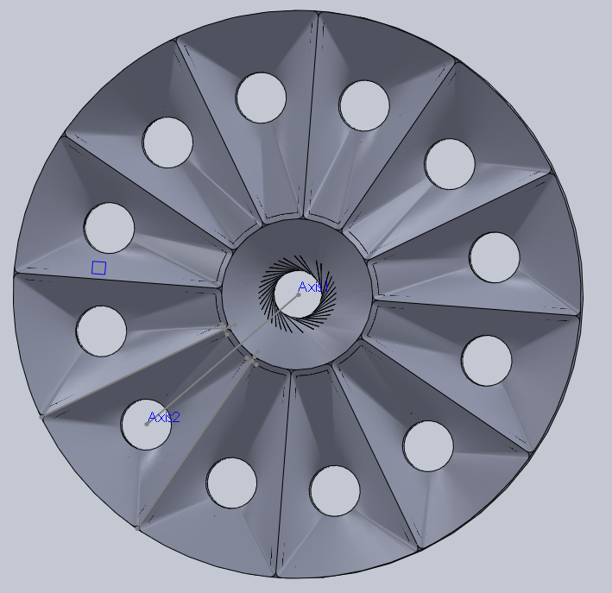
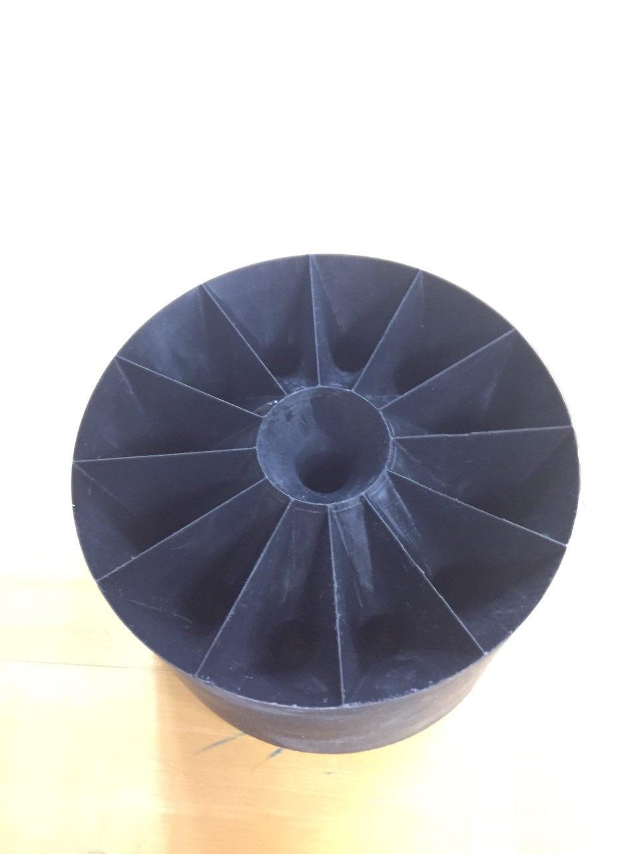
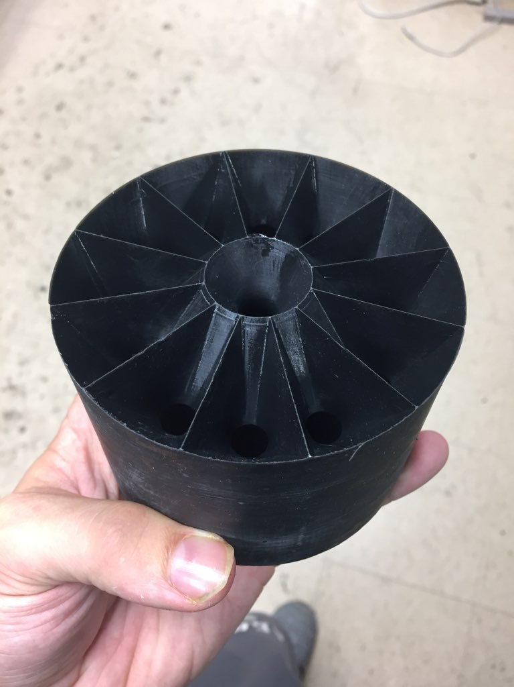
New flow-enhanced design
The tapered input channel serves as a nozzle and should allow for a higher fraction of air to flow through the waveguides
Increasing the depth of the tapered section should decrease drag, but at the expense of overall sample size.
New Design SolidWorks® Model
New Design 3D Model

Slide 10
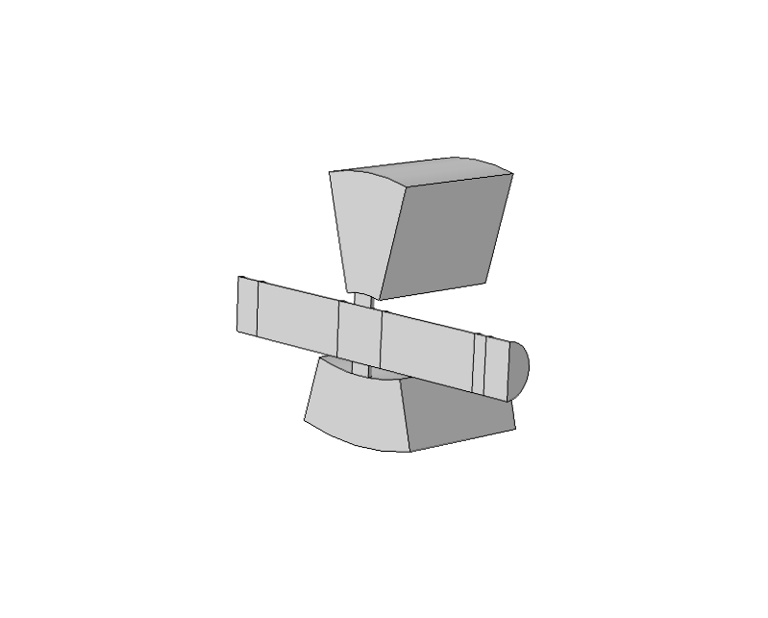
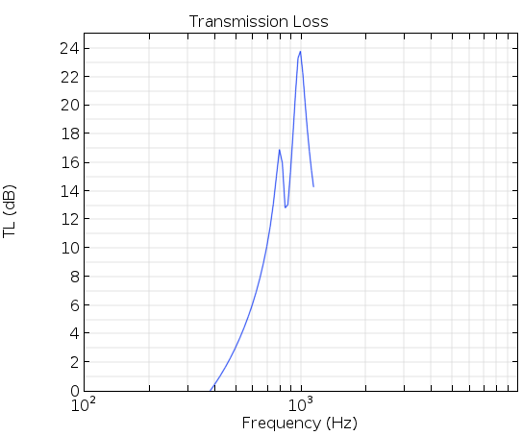
COMSOL® Simulations
COMSOL® Model for New Sample
New COMSOL® Software
LiveLinkTM for SolidWorks®
Load SolidWorks® files natively into COMSOL®
Edit the SolidWorks® files in COMSOL®
Upcoming Simulations
Simulation for the current sample design and the new flow-enhanced design
Currently still on the SolidWorks® LiveLinkTM learning curve
Outer Resonator
Inner Resonator
Initial COMSOL® results
Resonance Peak is seen at:
~ 1000 [Hz]
~ 800 [Hz]
Volume of the inner and outer resonators are slightly different in first iteration.
This was due to an oversight when making the SolidWorks model

